Slide 1
jQuery
Lecturer: Ngo Huy Bien
Software Engineering Department
Faculty of Information Technology
University of Science
Ho Chi Minh City, Vietnam
nhbien@fit.hcmus.edu.vn

Slide 2
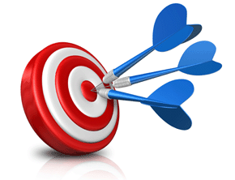
Objectives
To implement UI interactions using jQuery.

Slide 3

Contents

Slide 4

References
Semmy Purewal (2014). Learning Web App Development. O'Reilly Media.
Maximiliano Firtman (2012). jQuery Mobile Up and Running. O’Reilly.

Slide 5
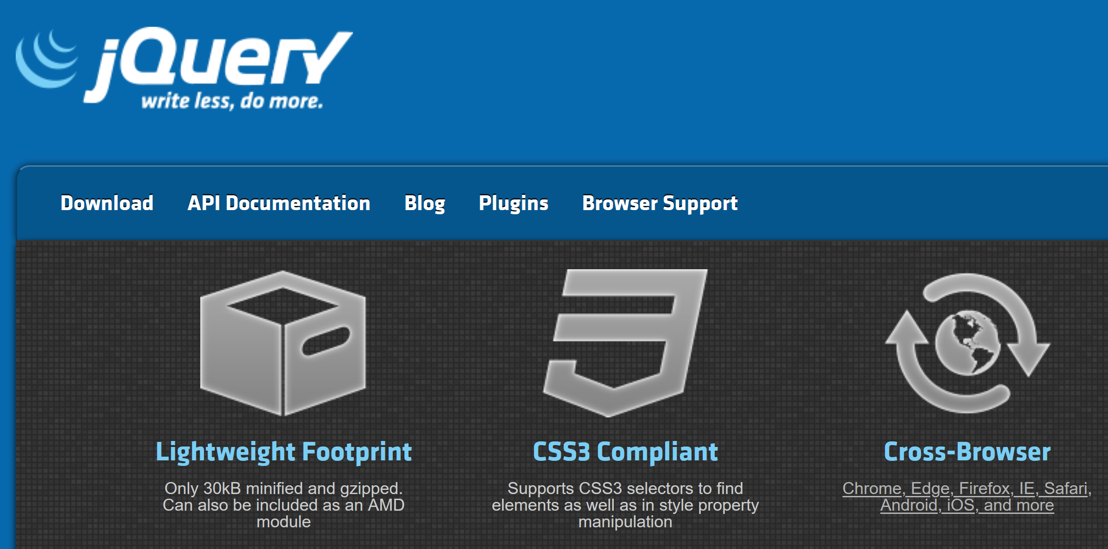
jQuery
https://jquery.com/
jQuery is a fast, small, and feature-rich JavaScript library.
It makes things like HTML document traversal and manipulation, event handling, animation, and Ajax much simpler with an easy-to-use API that works across a multitude of browsers.

Slide 6
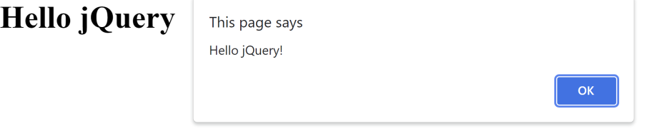
1. Create Hello World [1]
* {
margin: 0;
padding: 0;
}
<head>
<title>Hello jQuery</title>
<link href="style.css" rel="stylesheet" type="text/css">
</head>
<body>
<h1>Hello jQuery</h1>
<script
src="https://code.jquery.com/jquery-3.6.0.min.js">
</script>
<script src="app.js"></script>
</body>
style.css
index.html
var main = function () {
"use strict";
window.alert("Hello jQuery!");
};
$(document).ready(main);
app.js

Slide 7
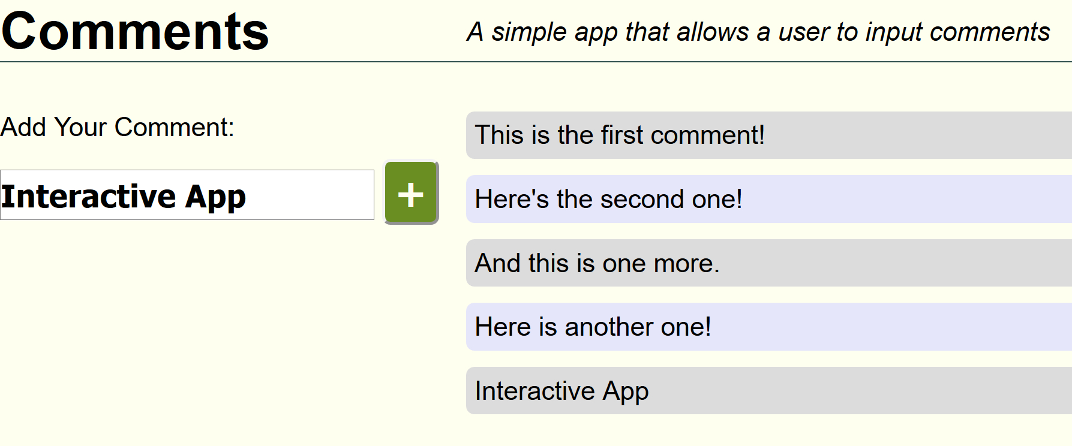
2. Handle Click Events
<section class='comment-input'>
<p>Add Your Comment:</p>
<input><button>+</button>
</section>
<section class='comments'>
<p>This is the first comment!</p>
<p>Here's the second one!</p>
<p>And this is one more.</p>
<p>Here is another one!</p>
</section>
var main = function () {
"use strict";
$(".comment-input button").on("click", function (event) {
var $new_comment = $("<p>"),
comment_text = $(".comment-input input").val();
$new_comment.text(comment_text);
$(".comments").append($new_comment);
});
};
$(document).ready(main);

Slide 8
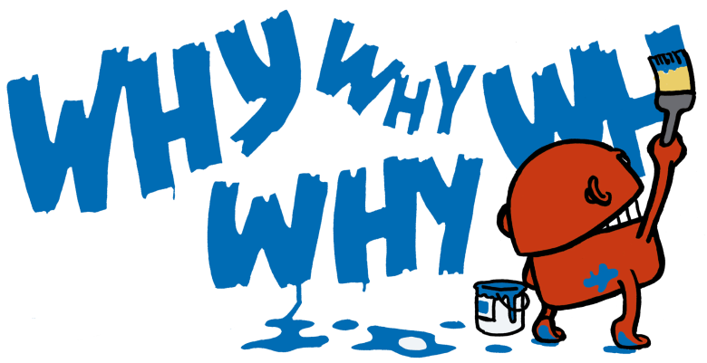
Why Use jQuery?
Essentially, jQuery offers us three things:
A streamlined, expressive approach to DOM manipulation
A consistent approach to DOM event handling
A simplified approach to AJAX

Slide 9
jQuery Selectors
https://api.jquery.com/category/selectors/
jQuery selectors are very similar to CSS selectors.
jQuery selectors aren’t identical to CSS selectors in all cases.
jQuery adds a rich set of pseudoclasses and pseudoelements that are not currently available in CSS.
$("*"); // selects all elements in the document
$("h1"); // selects all of the h1 elements
$("p"); // selects all of the p elements
$("p .first"); // selects all paragraph elements with the class 'first'
$(".first"); // selects all elements with the class 'first'
$("p:nth-child(3)"); // selects all paragraph elements that are the third child

Slide 10
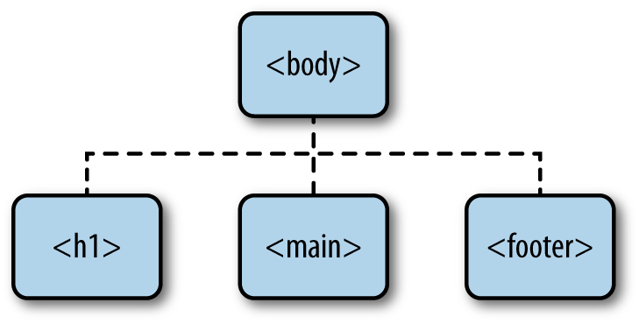
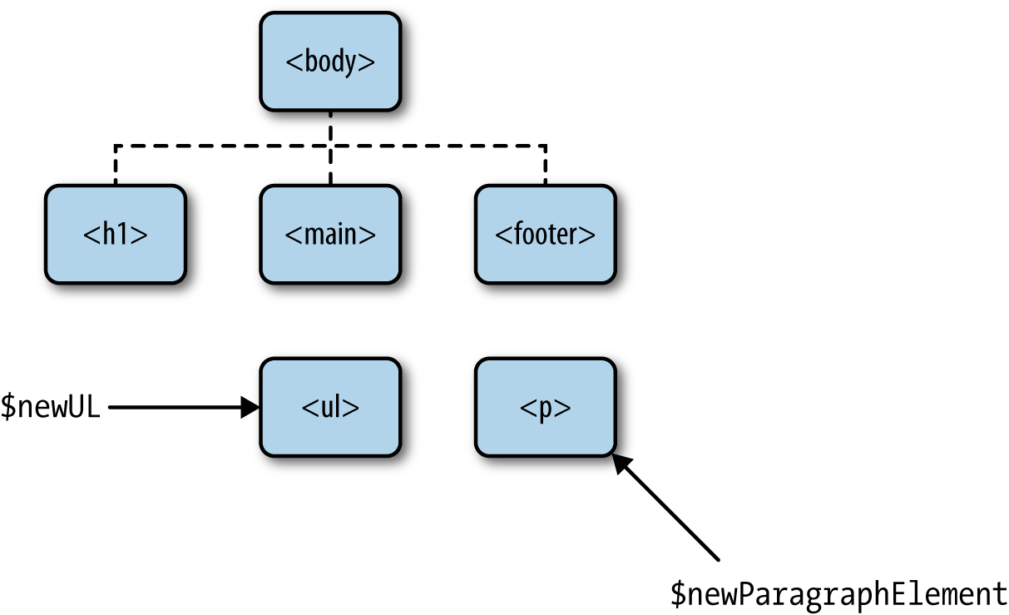
3. Create Elements
<body>
<h1>This is an example!</h1>
<main>
</main>
<footer>
</footer>
</body>
// By convention, I start jQuery object variables with a $
var $newUL = $("<ul>"); //create a new li element
var $newParagraphElement = $("<p>"); // create a new p element
$newParagraphElement.text("this is a paragraph");

Slide 11
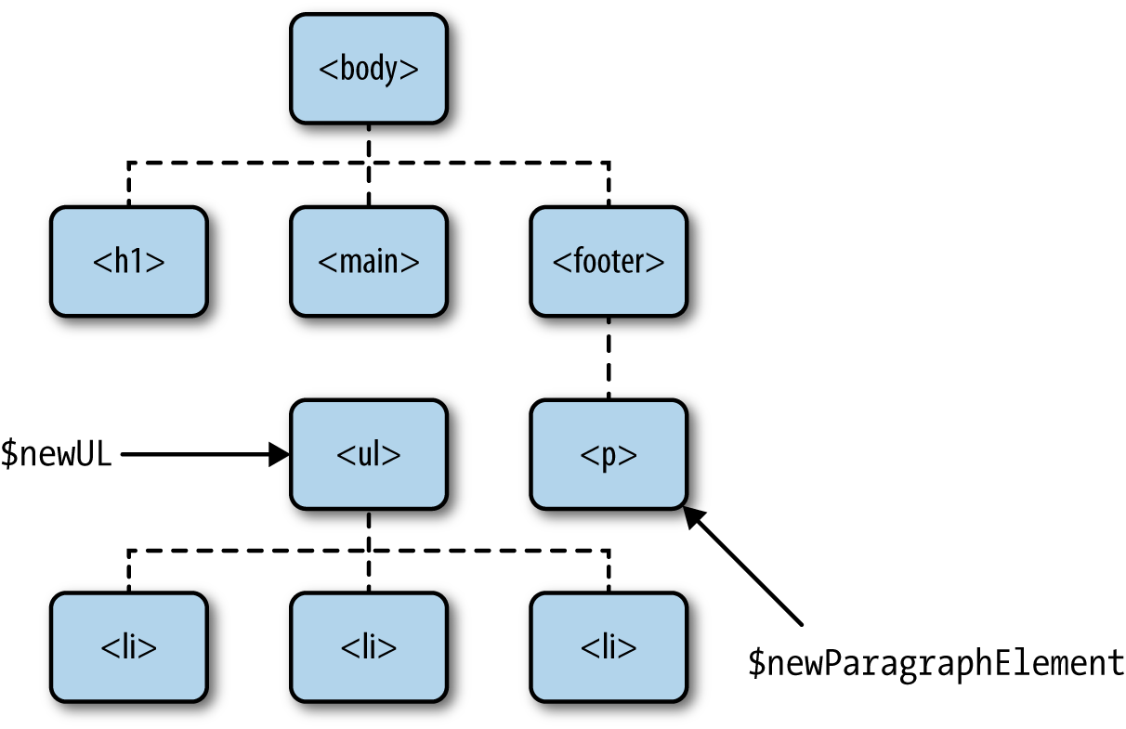
4. Add Elements to the DOM
// By convention, I start jQuery object variables with a $
var $newUL = $("<ul>"); //create a new li element
var $newParagraphElement = $("<p>"); // create a new p element
$newParagraphElement.text("this is a paragraph");
$("footer").append($newParagraphElement);
// we can chain our creation and call to add the text
var $listItemOne = $("<li>").text("this is the first list item");
var $listItemTwo = $("<li>").text("second list item");
var $listItemThree = $("<li>").text("OMG third list item");
// now we'll append these elements to the ul element we created earlier
$newUL.append($listItemOne);
$newUL.append($listItemTwo);
$newUL.append($listItemThree);
// $("main").append($newUL);

Slide 12
Events and Asynchronicity
With asynchronous programming, certain event-related functions take callbacks, or functions that are to be executed later, as arguments.
This makes it so the execution order is not always so clear.
console.log("this will print first");
console.log("this will print second");
console.log("this will print third");
console.log("this will print first");
$("button").on("click", function () {
console.log("this will only print when someone clicks");
});
console.log("this will print second");

Slide 13
Anonymous Function Example
// This is a jQuery event that executes the callback
// when the DOM is ready. In this example, we're using
// an anonymous function instead of sending the main
// function as an argument
$(document).ready(function () {
console.log("this will print when the document is ready");
});
// This is a built-in JavaScript function that executes
// after the specified number of milliseconds
setTimeout(function () {
console.log("this will print after 3 seconds");
}, 3000);
// this will print before anything else, even though
// it appears last
console.log("this will print first");

Slide 14
Masked Input Plugin for jQuery
https://github.com/digitalBush/jquery.maskedinput/
jQuery(window).bind('load', function(){
jQuery("[name^=wpcf-applicant-home-phone]").mask("(999) 999-9999");
jQuery("[name^=wpcf-applicant-work-phone-number]").mask("(999) 999-9999");
jQuery("[name^=wpcf-family-member-1-phone-number]").mask("(999) 999-9999");
jQuery("[name^=wpcf-applicant-home-phone]", "[name^=wpcf-applicant-work-phone-number]",
"[name^=wpcf-family-member-1-phone-number]").on("blur", function() {
var last = jQuery(this).val().substr( jQuery(this).val().indexOf("-") + 1 );
if( 3 == last.length ) {
var move = jQuery(this).val().substr( jQuery(this).val().indexOf("-") - 1, 1 );
var lastfour = move + last;
var first = jQuery(this).val().substr( 0, 9 );
jQuery(this).val( first + '-' + lastfour );
}
});
});

Slide 15
5. Show/Hide Panel using jQuery
https://crunchify.com/jquery-very-simple-showhide-panel-on-mouse-click-event/
div.opg_panel{
margin: 0px -5px 0px 0px;
padding: 0px 10px 0px 10px;
background: #f6f6f6;
border: solid 1px #000000;
display: none;
}
<div class="row form-group col-md-12">
<span class="opg_notice">Note: There is specific criteria that constitutes an Emergency Referral. You must review <a href ="javascript:void(0);" class="opg_flip">this information</a> before completing this section.
</span>
</div>
<div class="row form-group col-md-12 opg_panel">
<h4><strong>Emergency Referrals and Emergency Guardianship</strong></h4>
<p>The Colorado Office of Public Guardianship (OPG) will consider emergency
</div>
jQuery(document).ready(function ($) {
$(".opg_flip").click(function() {
$(".opg_panel").slideToggle("slow");
});
});

Slide 16


Slide 17
jQuery UI [2]
https://jqueryui.com/
jQuery UI is a curated set of user interface interactions, effects, widgets, and themes built on top of the jQuery JavaScript Library.
Whether you're building highly interactive web applications or you just need to add a date picker to a form control, jQuery UI is the perfect choice.

Slide 19
jQuery Mobile Alternatives
https://getbootstrap.com/
https://tailwindcss.com/

Slide 21
jQuery Mobile
http://jquerymobile.com/
jQuery Mobile is a HTML5-based user interface system designed to make responsive web sites and apps that are accessible on all smartphone, tablet and desktop devices.

Slide 22
Page
The page is the primary unit of interaction in jQuery Mobile and is used to group content into logical views that can be animated in and out of view with page transitions.
By setting the viewport attributes to content="width=device-width, initial-scale=1", the width will be set to the pixel width of the device screen.
<!DOCTYPE html>
<html>
<head>
<title>Page Title</title>
<meta name="viewport" content="width=device-width, initial-scale=1">
<link rel="stylesheet" href="http://code.jquery.com/mobile/1.4.2/jquery.mobile-1.4.2.min.css" />
<script src="http://code.jquery.com/jquery-1.9.1.min.js"></script>
<script src="http://code.jquery.com/mobile/1.4.2/jquery.mobile-1.4.2.min.js"></script></head>
<body>
...content goes here...
</body>
</html>

Slide 23
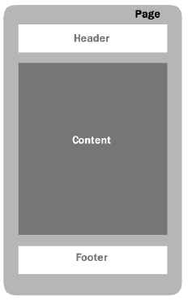
The Page
Inside the <body> tag, each view or "page" on the mobile device is identified with an element (usually a div) with the data-role="page" attribute.
Within the "page" container, any valid HTML markup can be used, but for typical pages in jQuery Mobile, the immediate children of a "page" are divs with data-role="header", class="ui-content", and data-role="footer“.
<div data-role="page">
<div data-role="header">...</div>
<div role="main" class="ui-content">...</div>
<div data-role="footer">...</div>
</div>

Slide 24
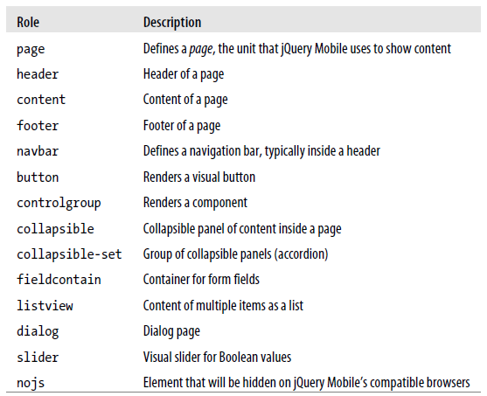
Roles [1]
jQuery Mobile uses standard HTML markup, such as the div tag.
To define what the framework should do with that div, we define a role.
A role in the framework is defined using the attribute data-role.

Slide 25
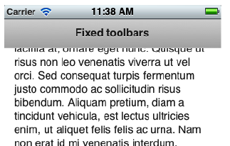
Toolbars
Toolbars are optional areas in our webapp defining headers and/or footers.
Every toolbar (header or footer) can be positioned in four ways:
Inline mode
Standard fixed mode
Full-screen fixed mode
True fixed mode
<div data-role="header">
<h1>Page's title</h1>
</div>

Slide 26

Adding Content to the Header
A header’s button is just a hyperlink; it uses an a element inside the header.
If we provide only one a element, it will be located at the left side of the title.
If we add two buttons, the first one will be located at the left and the second one at the right of the title.
<div data-role="header">
<a href="logout">Log out</a>
<h1>Title</h1>
<a href="settings" data-icon="gear">Settings</a>
</div>

Slide 27
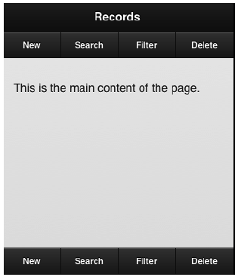
Navigation Bars
A navigation bar (also known as a navbar) is a set of links that can be placed at a toolbar, usually a footer, that combine to create a series of exclusive options.
The idea of a navigation bar is to act as a main navigation method for our webapp.
<div data-role="navbar">
<ul>
<li><a href="link1">Option 1</a>
<!-- ... -->
<li><a href="linkn">Option n</a>
</ul>
</div>

Slide 28
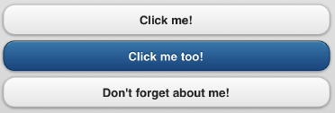
Buttons
A button is a UI component that feels like…well, a button.
That is, a larger clickable area with text and optionally an icon.
A button can be created in different ways:
Using a button element
Using an input element that typically renders a button, including type="button",
type="submit", type="reset" and type="image"
Any a element with data-role="button"
<a href="#" data-role="button">Click me!</a>
<button data-theme="b">Click me too!</button>
<input type="button" value="Don't forget about me!">

Slide 29
Buttons Note
Buttons in jQuery Mobile are automatically styled, making them attractive and useable on both mobile devices and desktop computers.
We recommend that you use the <a> element with class="ui-btn" to link between pages, and <input> or <button> elements for form submission.
Note: Before version 1.4, we used the data-role="button" attribute to create a button in jQuery Mobile.
As of 1.4, the framework use CSS classes to style buttons (except for <input> buttons).

Slide 30

Grouped Buttons
<div data-role="controlgroup" data-type="horizontal">
<a href="#" data-role="button" data-inline="true">Button 1</a>
<a href="#" data-role="button" data-inline="true">Button 2</a>
<a href="#" data-role="button" data-inline="true">Button 2</a>
</div>

Slide 31
Grids
<div class="ui-grid-b">
<div class="ui-block-a">Block A</div>
<div class="ui-block-b">Block B</div>
</div>
<div class="ui-grid-b">
<div class="ui-block-a" style="width:80%;">Block A</div>
<div class="ui-block-b" style="width:20%;">Block B</div>
</div>

Slide 32
Form Action
A typical jQuery Mobile form will look very similar to a typical web form:
If we want to force a standard HTTP request without AJAX, we can use data-ajax="false" on the form element.
<form action="send.php" action="get">
</form>

Slide 33
Mobile Initialization Event
Mobile initialization is fired after the jQuery Mobile framework is loaded into memory and just before rendering the UI elements.
That is why we can use this event handler to change some of the UI global preferences.
<script src=“./jquery.mobile-1.4.2/jquery-1.9.1.min.js”></script>
<script type = “text/javascript”>
$(document).bind('mobileinit', function() {
// Initialization code here
});
</script>
<script src=“./jquery.mobile-1.4.2/jquery.mobile-1.4.2.min.js"></script>

Slide 34
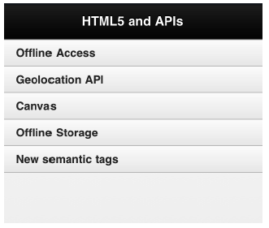
Lists
A list is just an ordered (ol HTML element) or unordered (ul HTML element) list inside a page with at least one list item (li HTML element) and the role defined as listview using the HTML5 syntax data-role="listview".
<div data-role="header">
<h1>HTML5 and APIs</h1>
</div>
<div data-role="content">
<ul data-role="listview">
<li>Offline Access
<li>Geolocation API
<li>Canvas
<li>Offline Storage
<li>New semantic tags
</ul>
</div>

Slide 35
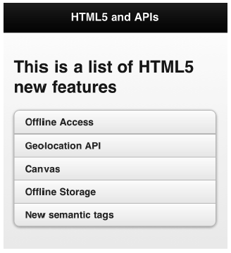
Inset Lists
<div data-role="header">
<h1>HTML5 and APIs</h1>
</div>
<div data-role="content">
<ul data-role="listview" data-inset="true">
<li>Offline Access
<li>Geolocation API
<li>Canvas
<li>Offline Storage
<li>New semantic tags
</ul>
</div>

Slide 36
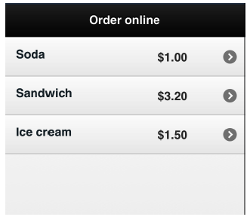
Aside Content
<div data-role="content">
<ul data-role="listview">
<li><a href="buy.html">Soda</a>
<span class="ui-li-aside">$1.00</span>
<li><a href="buy.html">Sandwich</a>
<span class="ui-li-aside">$3.20</span>
<li><a href="buy.html">Ice cream</a>
<span class="ui-li-aside">$1.50</span>
</ul>
</div>

Slide 37
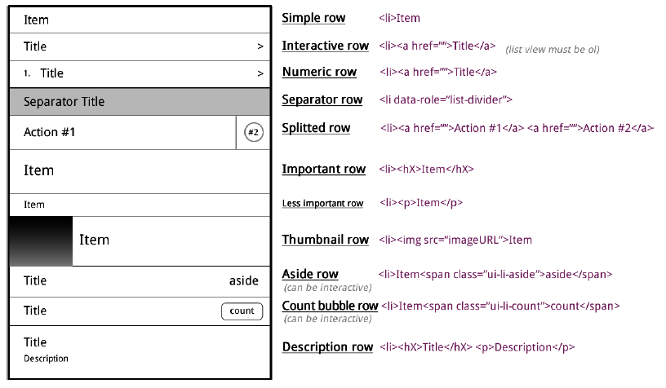
Title and Description

Slide 38
Icons
http://api.jquerymobile.com/icons/

Slide 39
Sliding Menu
<div data-role="panel" id="navpanel" data-theme="a" data-display="overlay" data-position="right">
<div data-role="controlgroup" data-corners="false">
<a href="#" data-role="button">Business</a>
<a href="#" data-role="button">Numbers</a>
</div>
</div>
<div id="header" data-role="header" data-theme="b">
<a id="bars-button" data-icon="bars" class="ui-btn-right" href="#navpanel">Menu</a>
</div>

Slide 40
AutoComplete
<input type="text" id="txtCar" value="Select a Car" />
<ul data-role="listview" data-inset="true" data-filter="true" data-filter-reveal="true" data-input="#txtCar" id="lstCars">
<li><a href="#">Audi</a></li>
<li><a href="#">BMW</a></li>
<li><a href="#">Ferrari</a></li>
<li><a href="#">Ford</a></li>
<li><a href="#">Honda</a></li>
<li><a href="#">Kia</a></li>
<li><a href="#">Lexus</a></li>
<li><a href="#">Volvo</a></li>
</ul>

Slide 41
Click Event
<input type="button" data-inline="true" id="btnAddCar" value="Add a Car" />
<ul data-role="listview" data-inset="true“ id="lstCars">
<li><a href="#">Audi</a></li>
<li><a href="#">BMW</a></li>
</ul>
$(document).on("pagecreate", function () {
$("#btnAddCar").on("click", function () {
alert("btnAddCar clicked");
$("#lstTo li").removeClass('ui-screen-hidden');
});
});

Slide 42
Dialogs
Any page can be presented as a modal dialog by adding the data-dialog="true" attribute to the page.
When any link is clicked within a dialog, the framework will automatically close the dialog and transition to the requested page, just as if the dialog were a normal page.
If a dialog opens another dialog (chaining), closing the last one with a link of type data-rel="back" will always navigate to the previous dialog until the root-page of type data-role="page" is reached.
<div data-role="page" data-dialog="true">
<div data-role="header" data-theme="b">
<h1>Dialog</h1></div>
<div role="main" class="ui-content">
<a href="dialog/index.html" data-rel="back" class="ui-btn ui-shadow ui-corner-all ui-btn- a">Cancel</a></div>
</div>

Slide 43
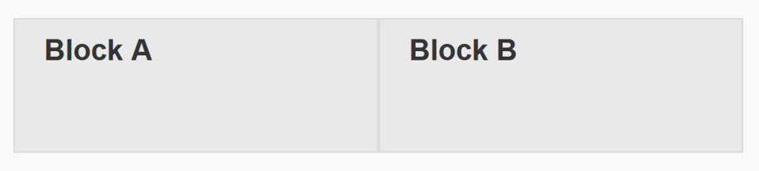
Grids
https://demos.jquerymobile.com/1.4.5/grids/
The jQuery Mobile framework provides a simple way to build CSS-based columns that can also be responsive.
<div class="ui-grid-a">
<div class="ui-block-a"><div class="ui-bar ui-bar-a" style="height:60px">Block A</div></div>
<div class="ui-block-b"><div class="ui-bar ui-bar-a" style="height:60px">Block B</div></div>
</div><!-- /grid-a -->

Slide 44

Thank You & See You Again

